Slide 1

Reddit Classification Project
Ariffin sarhid

Slide 2
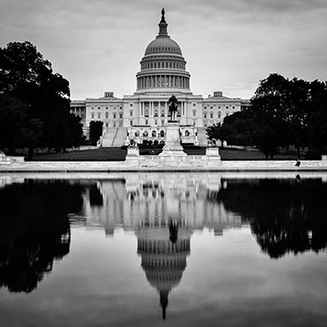
Agenda
Problem Statement
Process
Word Cloud
Modeling
Results
Feature Importance
Opportunity For Improvement

Slide 3

PROBLEM STATEMENT
The goal of this project is to build a binary classification model that predicts if a post from reddit belongs to the "War" or "Politics" subreddit. The model will be chosen if the Accuracy and F1 score are the highest.

Slide 4
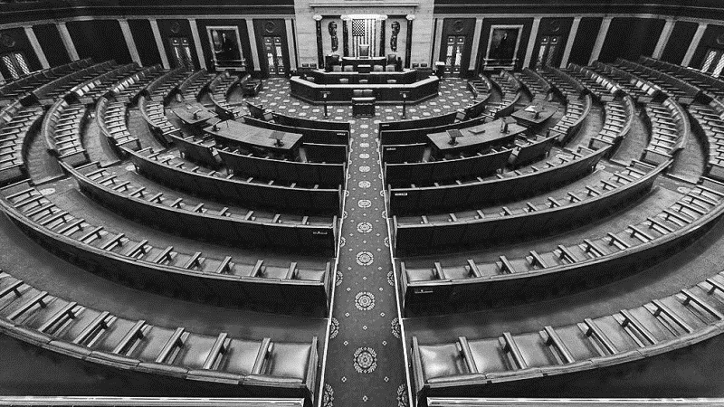
process
Obtaining Data & Data Cleaning
Pushshift API to collect data. Total of 1000 post of each subreddit
Feature Engineering & EDA
Selected Subreddit, Title and Selftext as features.
Mapping Politic and War subreddit as 0 and 1 target, respectively.
Preprocessing
Stop Word (‘English’)
Visualizing top 25 Words in each subreddit and Word Cloud
Removing html tags and punctuations using Regexp Tokenizer
WordNet Lemmatizer
Identifying Baseline Score – 0.5
Train/ Test Split – 0.7/ 0.3 respectively
Modeling
Setting up Pipeline & Parameter
Confusion Matrix
Run Model
Combined Title and Selftext as X variable and Subreddit as Y variable.
Evaluate Score
Checked for empty columns
Lowercase all texts
Fill na with (“”)
Cross validation = 3

Slide 5
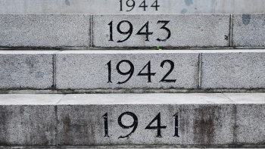
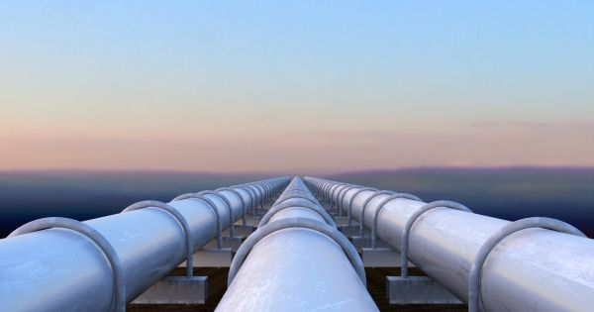
Modeling
1st Pipeline
CountVectorizer + Random Forest
Params_cvec_rf = {
'cvec__max_features' : [2000, 2500],
'cvec__stop_words': ['english', None],
'cvec__ngram_range': [(1,1), (1,2)],
'cvec__max_df': [.8, .9],
'cvec__min_df': [2, 3],
'rf__max_depth' : [5, 6],
'rf__n_estimators': [150, 200, 250],
'rf__min_samples_split': [1,2,3]}
2nd Pipeline
CountVectorizer + Logistic Regression
params_cvec_logreg = {
'cvec__max_features' : [2000, 2500],
'cvec__stop_words': ['english', None],
'cvec__ngram_range': [(1,1), (1,2)],
'cvec__max_df': [0.8, 0.9],
'cvec__min_df': [2, 3],
'logreg__penalty': ['l1', 'l2'],
'logreg__C': [0.01, 0.1, 1]}

Slide 6
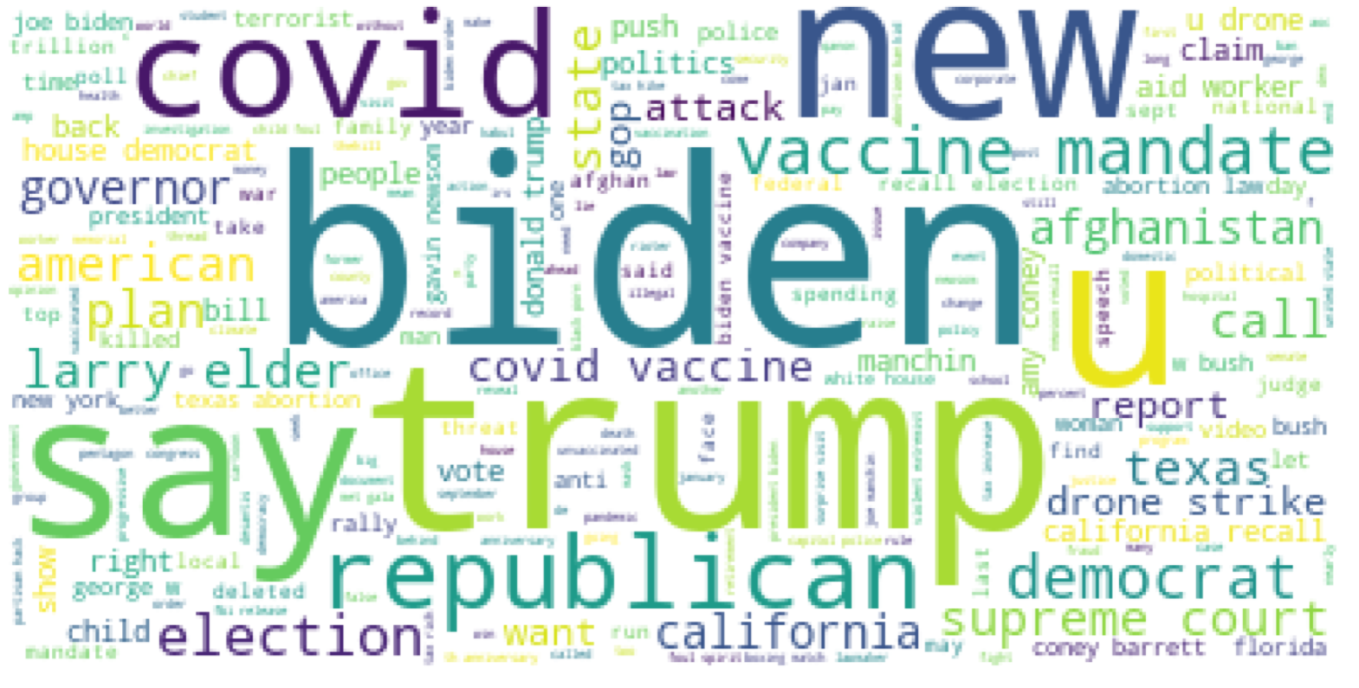
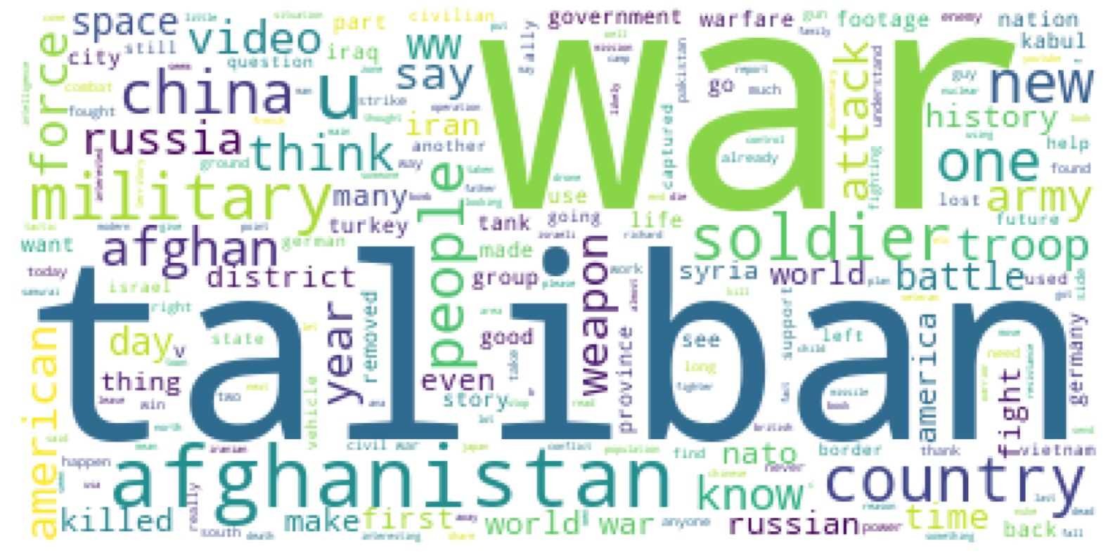
EDA-Word Cloud

Slide 7

Results
Model | Train | Test | Specificity | Precision | F1 | Recall | ROC_AUC
cvec_rf | 0.889697 | 0.829091 | 0.909091 | 0.891775 | 0.81423 | 0.74909 | 0.94204
cvec_logreg | 0.985455 | 0.898182 | 0.861818 | 0.871186 | 0.90175 | 0.93455 | 0.97114

Slide 8
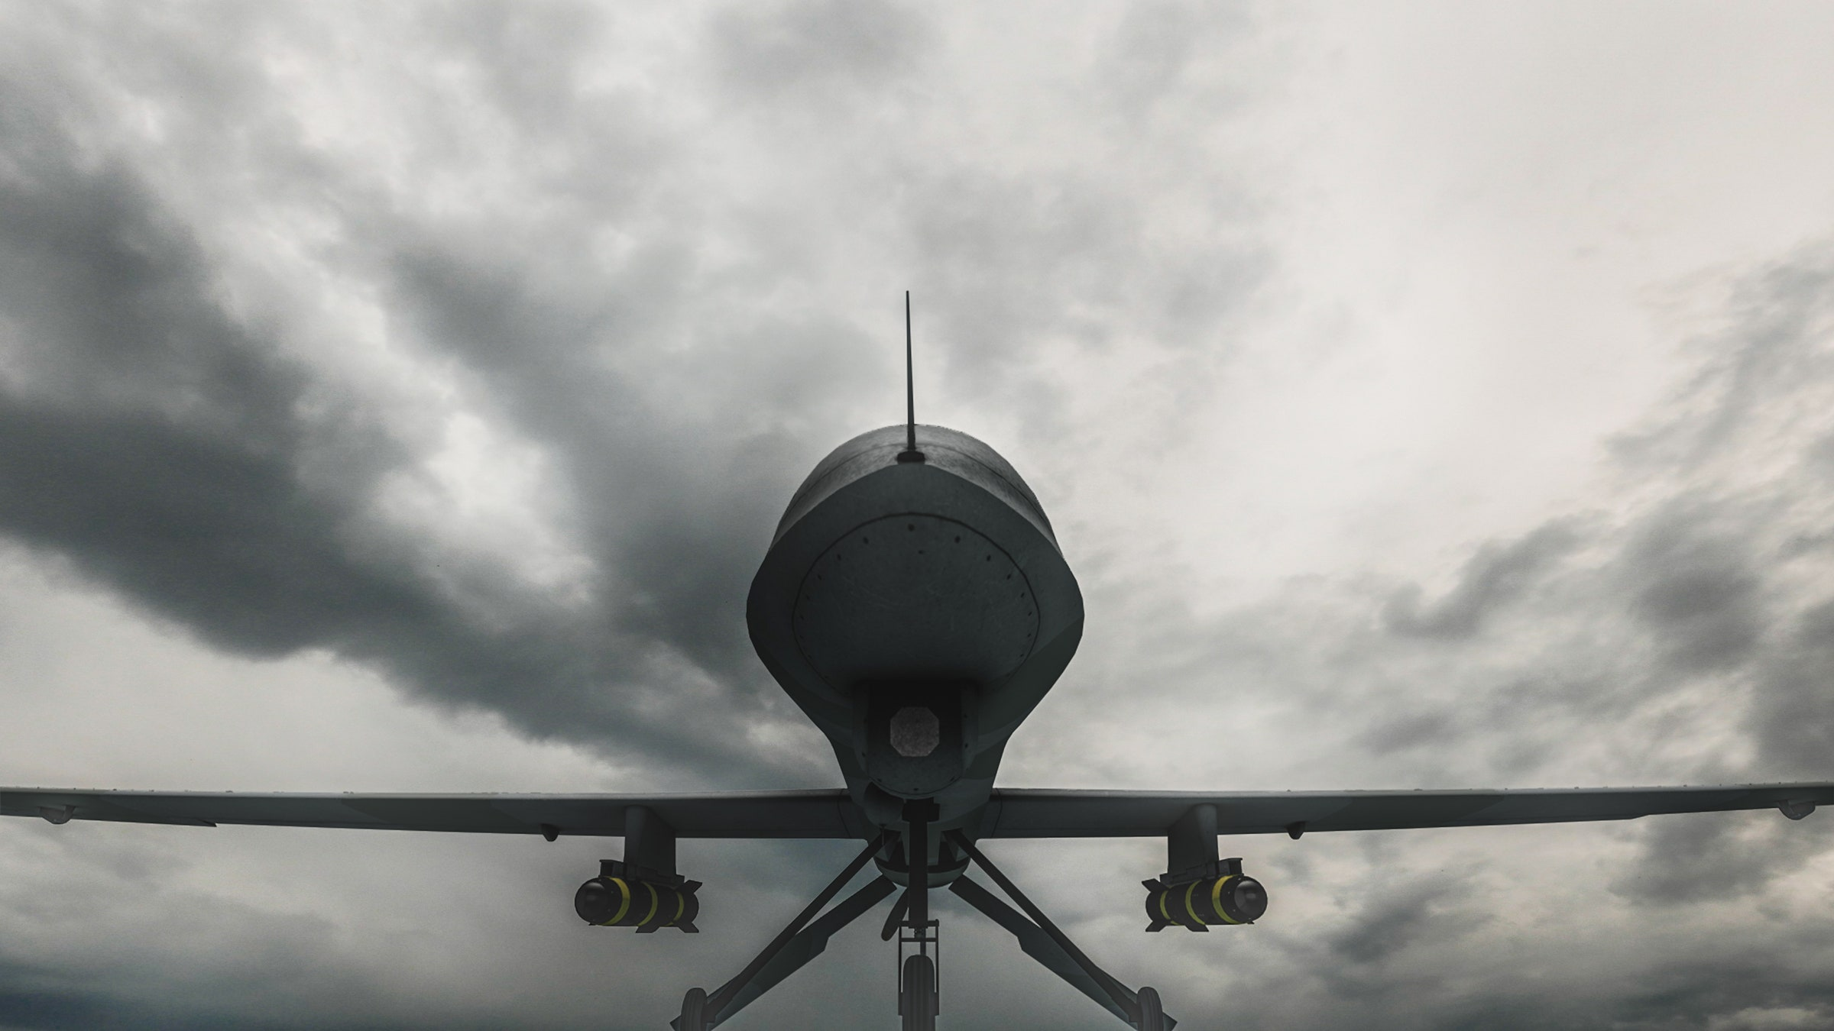
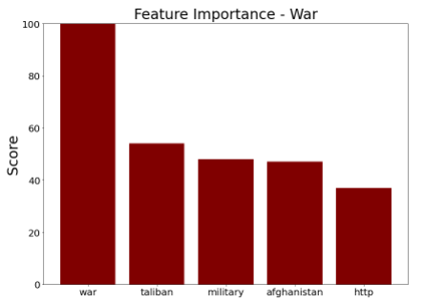
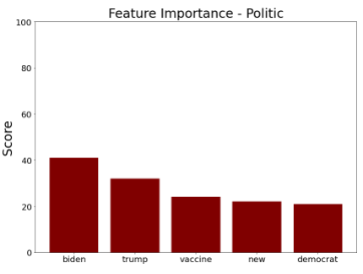
Feature Importance

Slide 9

Opportunity for Improvement
Develop a set of StopWords for the model which includes 'war' as a StopWords.
Train and test the data on more models so as to have more options to analyse the different scores.

Slide 10



THANK YOU
Ariffin Sarhid
https://git.generalassemb.ly/ariffinsarhid
linkedin.com/in/ariffin-sarhid/
Questions?

